Slide 1







SHOPSITE
shopsite
ShopSite is an innovative e-commerce platform aimed at providing users with a seamless shopping experience. Developed by Sujoy and Souvik Das
01

Slide 2



Agenda
01
About Project
05
Summery
09
collaboration
02
keys fetures using Tools
06
Admin DashBoard
10
Contact Us
03
shopsite target
07
User Dashboard
11
Deployment
04
Team Member
08
source code
12
conclusion
02

Slide 3

About
Our Project
A COLLABORATIVE EFFORT BY SUJOY AND SOUVIK DAS. REVOLUTIONIZING E-COMMERCE WITH MONGODB, NODE.JS, EJS, SCSS, BOOTSTRAP, STRIPE PAYMENT, GOOGLE AUTH, AND SESSION COOKIES FOR SEAMLESS, SECURE ONLINE SHOPPING.
03

Slide 4

Project
Key Features
MongoDB: Store user, product data securely for efficient retrieval.
Session cookies: Manage user authentication, track user sessions securely.
Google Authentication: Integrate OAuth for secure user login process.
EJS Templating: Dynamically render HTML content with MongoDB data.
Bootstrap: Develop responsive, visually appealing front-end interfaces efficiently.
Docker Images: Containerize application components for consistent deployment.
User Authentication: Enable Google sign-in, manage sessions securely with cookies.
Product Management: CRUD operations for product listings, backed by MongoDB.
Cart Functionality: Add, view, update cart contents seamlessly during shopping.
Order Processing: Confirm, process orders securely with MongoDB storage.
04

Slide 5


Project
Target & Result
ShopSite integrates MongoDB, Node.js, and Bootstrap to create a modern, scalable, and robust e-commerce platform
With features like Google Authentication and session cookies, ShopSite prioritizes data security, ensuring safe transactions for users
ShopSite focuses on delivering a smooth shopping experience, utilizing EJS for dynamic content generation and SCSS for customizable styling
05

Slide 6

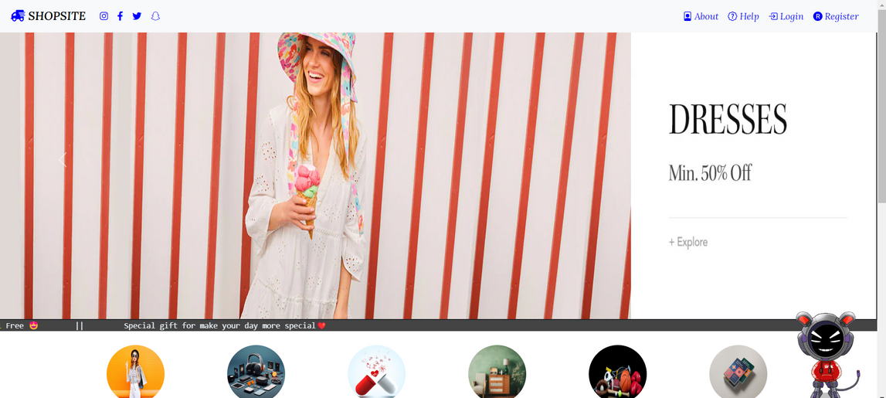
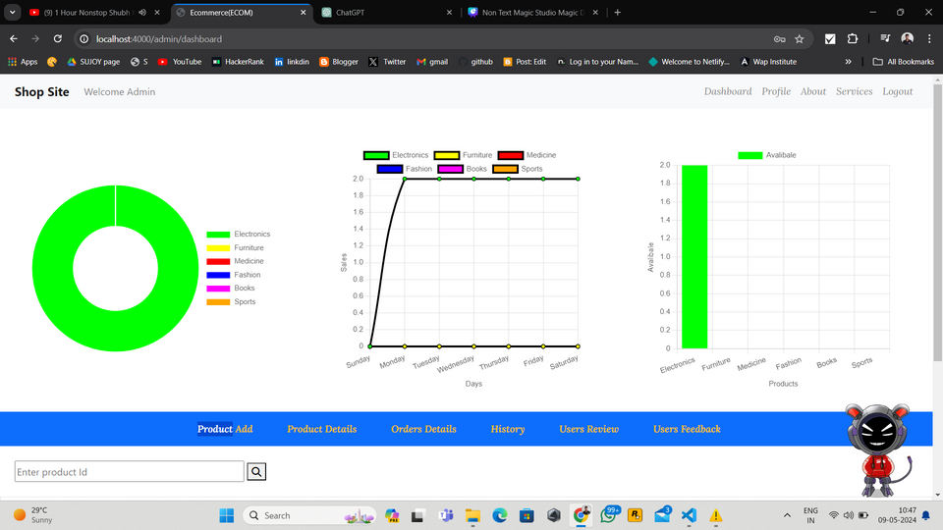
Project
Overview
Our Overview
ShopSite is an innovative e-commerce platform developed by Sujoy and Souvik Das. Leveraging MongoDB, Node.js, EJS, SCSS, Bootstrap, Stripe Payment, Google Auth, and session cookies, it aims to revolutionize online shopping with secure transactions and a seamless user experience.
06

Slide 7


Project
Team
SUJOY GHOSHAL
souvik Das
07

Slide 8
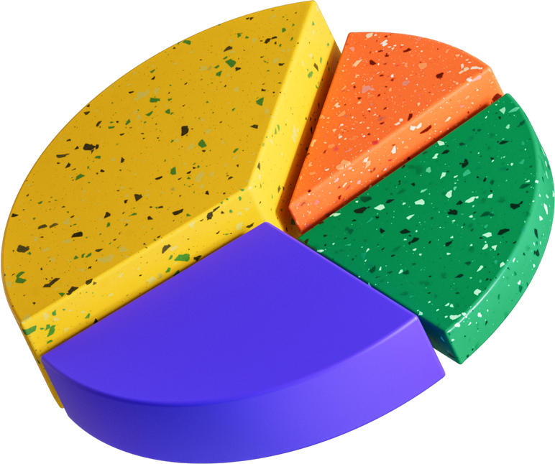
Benefits
User-Friendly Interface
Scalability
ShopSite ensures seamless shopping, boosting engagement.
Leveraging MongoDB and Node.js, it scales effortlessly to meet growing demands.
Customization and Convenience
Enhanced Security
Google Authentication and session cookies protect user data.
ShopSite offers template variety and Stripe Payment integration, simplifying checkout for a tailored experience.
08

Slide 9


Project
Summary
About executive summary
Sujoy and Souvik Das, redefines e-commerce with MongoDB, Node.js, EJS, SCSS, Bootstrap, Stripe Payment, Google Auth, and session cookies. Offering scalability, security, and customization, it promises a seamless, secure, and personalized online shopping experience.
09

Slide 10
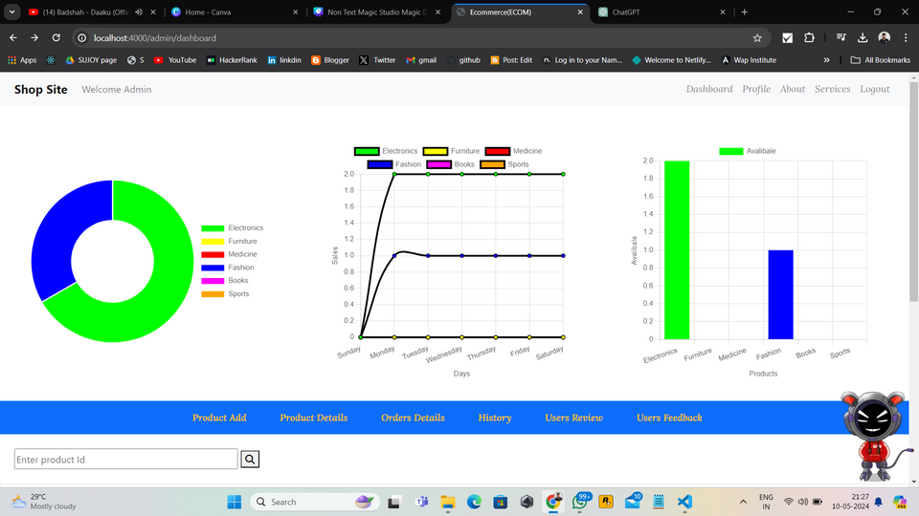
Admin Dashboard
Responsive Graph: Implement a dynamic graph that adjusts seamlessly to different screen sizes for optimal viewing across devices.
Real-Time Data: Ensure the graph displays up-to-date information on all products, reflecting changes in stock levels instantly.
Product Availability: Represent the availability of each product using the graph, allowing admins to quickly identify items that are low in stock or out of stock.
Stock Levels: Provide visual cues such as color-coding or line graphs to indicate stock levels over time, enabling admins to track trends and plan inventory management strategies effectively.
User-Friendly Interface: Design the admin page with a user-friendly interface, making it intuitive for admins to interact with the graph and access detailed information about product availability and stock.
Data Visualization: Utilize graphing libraries or tools to create visually appealing and informative graphs that enhance data visualization and decision-making for administrators.
10

Slide 11
User Dashboard
User Registration and Login: Allow users to create accounts, log in securely, and manage their profiles, including personal information, addresses, and order history.
Product Browsing and Search: Enable users to search for products by category, keyword, or filters, and browse product listings with detailed descriptions, images, and pricing.
Add to Cart and Wishlist: Allow users to add products to their shopping cart for purchase and save items to their wishlist for future consideration or sharing.
Cart Management: Provide functionality for users to view and edit the contents of their shopping cart, update quantities, and proceed to checkout seamlessly.
Checkout Process: Streamline the checkout process with a user-friendly interface, multiple payment options, and support for shipping and billing addresses.
Order Tracking: Allow users to track the status of their orders in real-time, with updates on order processing, shipping, and delivery.
11

Slide 12
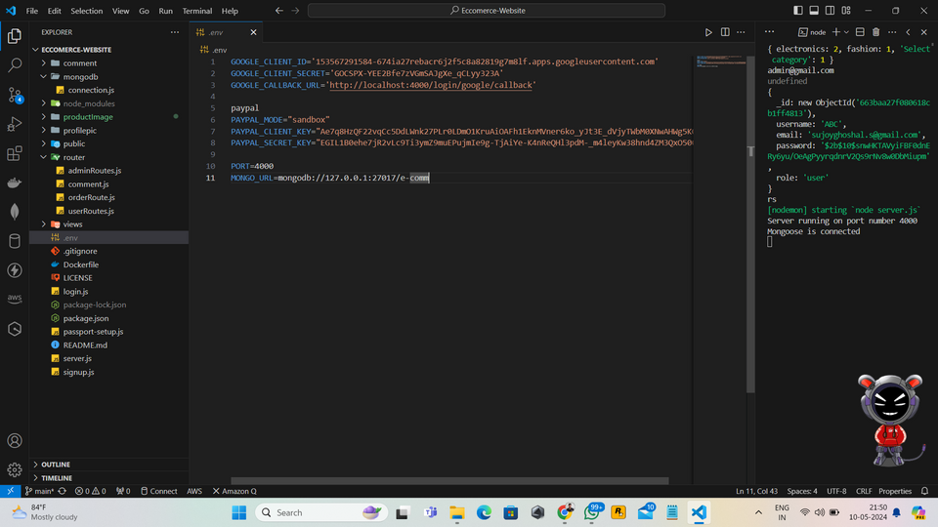


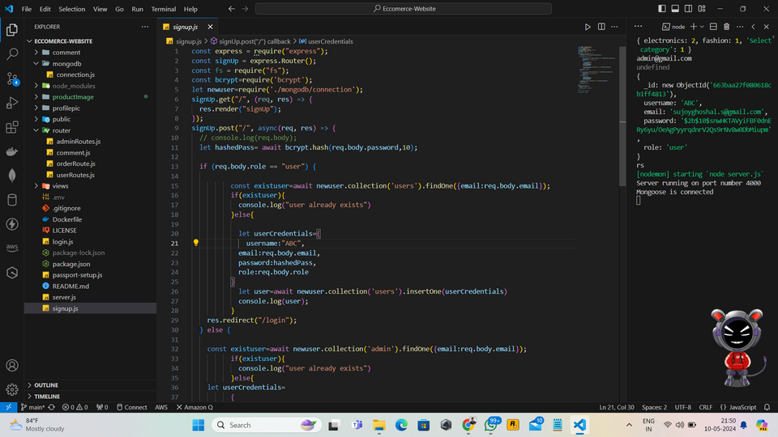
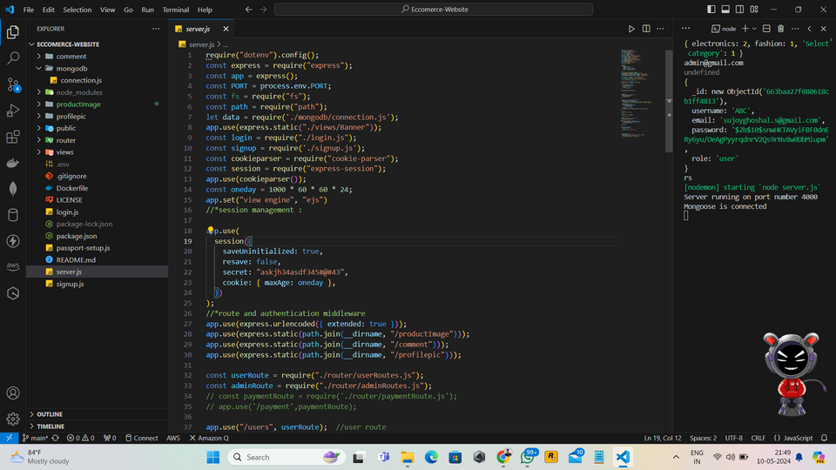

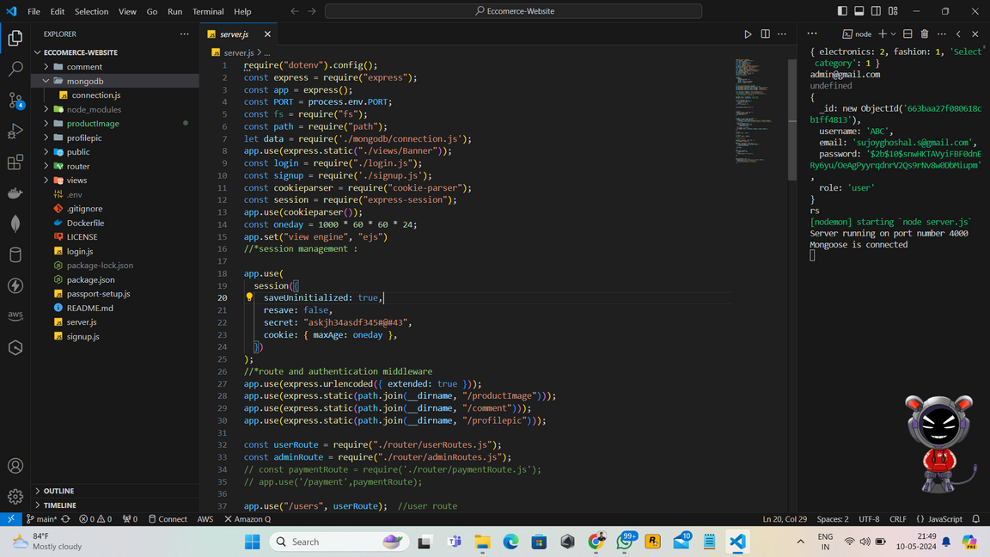
SHOPSITE
PROJECT SOURCE CODE
server.js:
routes.js:
Express Setup: In server.js, configure an Express server to handle HTTP requests efficiently. Define middleware for parsing JSON data, handling CORS, and error management. Initialize the server to listen on a specified port.
Route Handling: In routes.js, define routes for various endpoints such as authentication, product management, cart functionality, and order processing. Organize endpoints logically to streamline request handling and code readability.
mongodb.js:
.env file:
Database Integration: In mongodb.js, establish a connection to MongoDB using Mongoose or the native MongoDB driver. Define schemas for different data entities like users, products, and orders. Implement CRUD operations.
Environment Configuration: Use a .env file to store sensitive information like database connection URIs and API keys as environment variables. Configure server settings such as the port number and session secret for enhanced security and portability.

Slide 13



Collaborate
Branch
gitHub
main
main
souvik Das
CONTRIBUTE
SUJOY GHOSHAL
shopsite
13

Slide 14


Contact Us
+91 8927673775
shopsite@gmail.com
Anywhere St., Any City
14

Slide 15
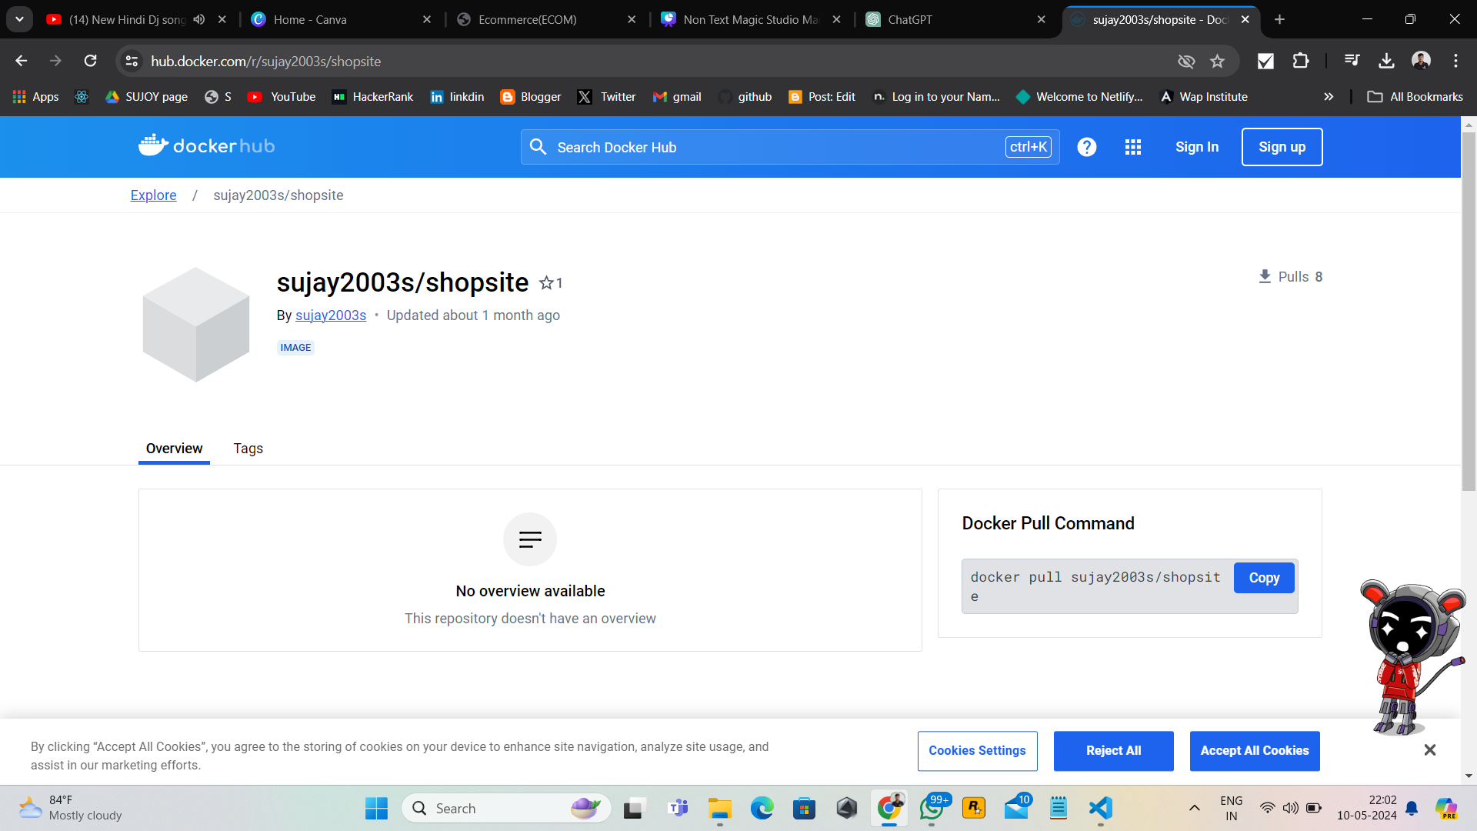
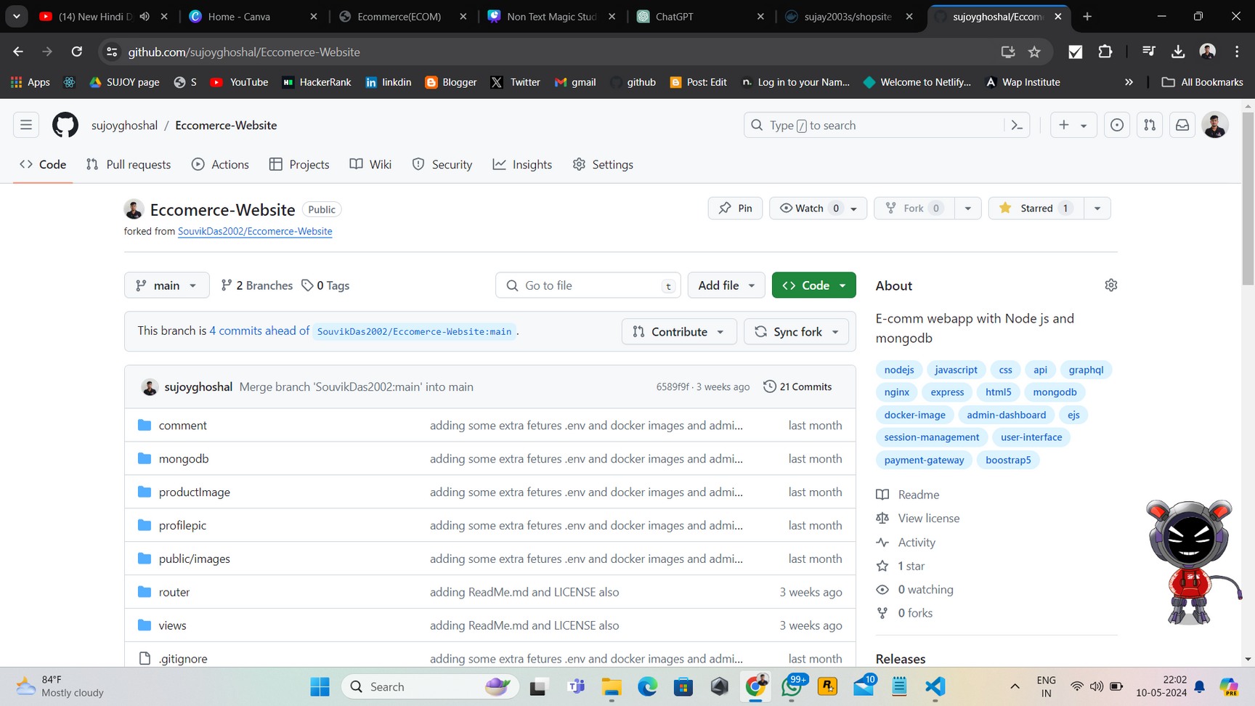
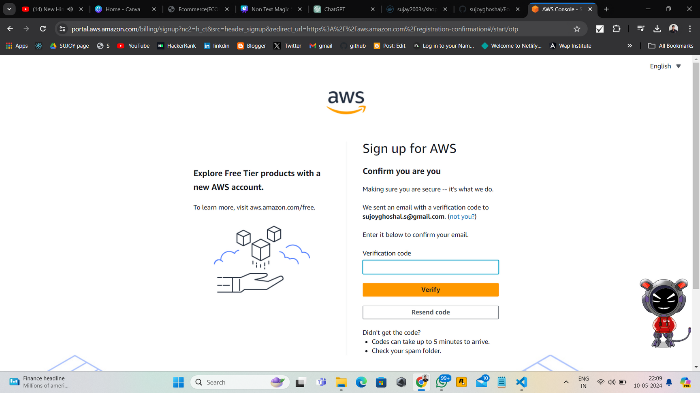
AMAZON EC2 DEPLOYMENT & GITHUB REPOSITORY
Amazon EC2 Deployment: Utilize Amazon EC2 for scalable, reliable hosting. Configure server environment, deploy application, manage resources efficiently. Ensure high availability and performance.
GitHub Repository: Centralize project code on GitHub for version control, collaboration. Maintain regular commits, branches, and documentation updates for streamlined development.
Docker Image Creation: Create Dockerfile for building Docker images. Define project dependencies, configurations, and commands for containerized deployment and scalability.

Slide 16
Project
conclusion
COLLABORATING ON GITHUB EMPOWERS TEAMS TO DEVELOP PROJECTS EFFICIENTLY AND EFFECTIVELY. BY LEVERAGING FEATURES SUCH AS REPOSITORY CREATION, ACCESS PERMISSIONS, PULL REQUESTS, AND ISSUE TRACKING, COLLABORATORS CAN SEAMLESSLY CONTRIBUTE TO THE PROJECT'S SUCCESS, FOSTERING INNOVATION AND COLLABORATION IN SOFTWARE DEVELOPMENT ENDEAVORS
16

Slide 17
THANK YOU

